Slide 1



UNIT 4
LESSON 16
What if…?
Part 5

Slide 2

Finish the sentences in as many different ways as possible.
School is…
School should…
School will….

Slide 3
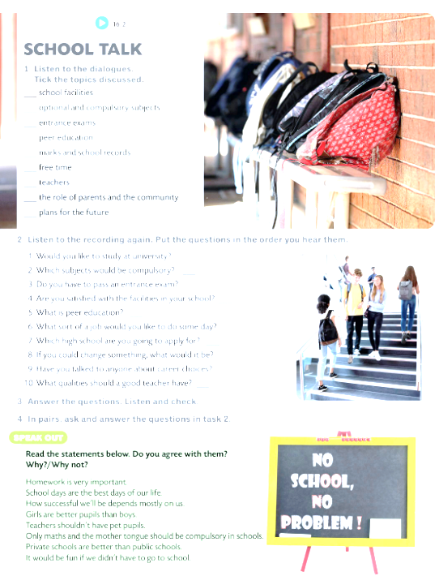
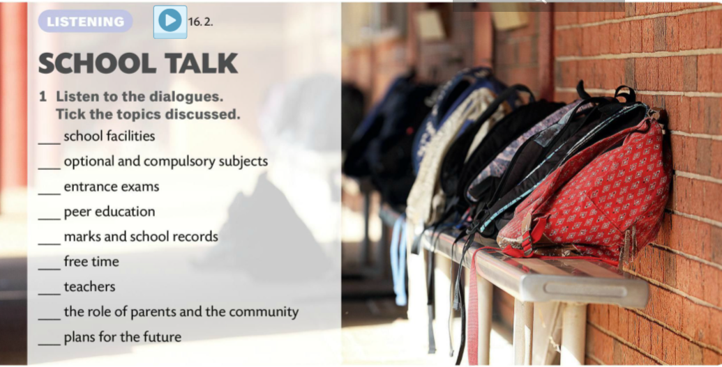



Slide 4
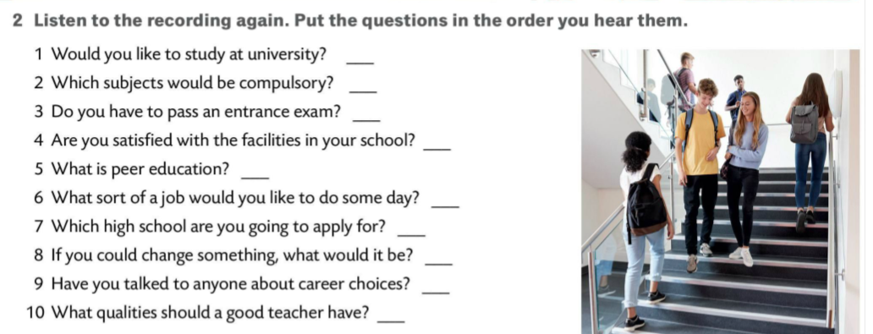
9
5
Listen to the recording again and check your answers.
7
1
3
10
6
4
8
2

Slide 5
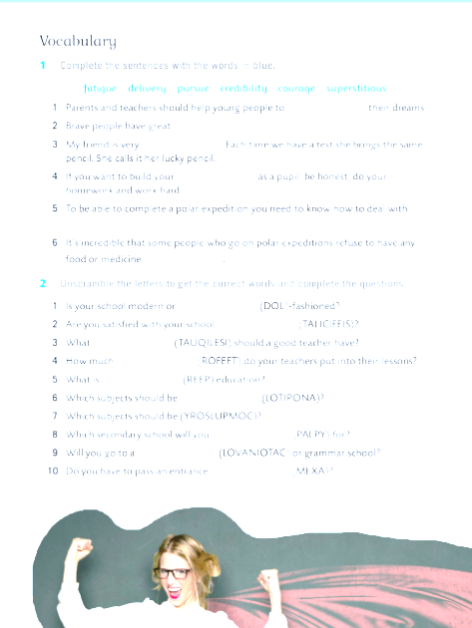
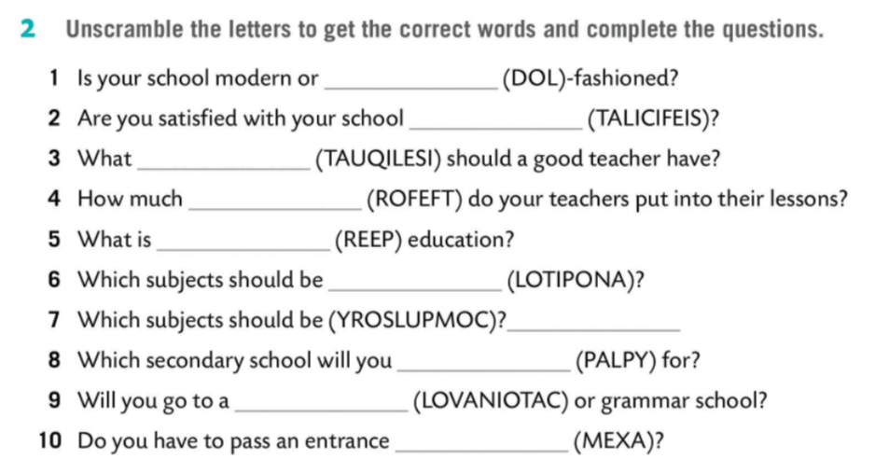
old
facilities
qualities
effort
peer
optional
compulsory
apply
vocational
exam

Slide 6


